Slide 1
Data Structure
String Processing
Mohammad Gazi Golam Faruque
Associate Professor
Department of Computer Science and Engineering
KHWAJA YUNUS ALI UNIVERSITY

Slide 2
Related CLOs
Course Learning Outcome (CLO)
CLOs | After successful completing this course, students will be able to. | PLO Mapping
CLO1 | Understand the concept of data structures to apply the algorithm for solving problems. | PO1, PO2
CLO2 | Choose a suitable algorithm to organize the data in several structure in computer. | PO4, PO5
CLO3 | Implement the various data structure algorithm for solving real-life problems. | PO2, PO3
CLO4 | Develop the new sustainable data structure to solve the upcoming problems. | PO12
CLO5 | Explore the various operations of linear, non-linear and dynamic data structures. | PO3, PO12

Slide 3
Discuss Topics
String
String Representation in memory
String Operation
String Processing Algorithm

Slide 4
String
A finite sequence S of zero or more characters is called a string. The number of characters in a string is called its length. The string with zero characters is called the empty string or the null string.
Specific strings will be denoted by enclosing their characters in single quotation marks. The quotation marks will also serve as string delimiters.
Each programming language contains a character set that is used to communicate with the computer.
This set usually includes the following:
Alphabet: A B C D E F G H I J K L M N O P Q R S T U V W X Y Z
Digits: 0 1 2 3 4 5 6 7 8 9
Special characters: + − / * ( ) , . $ = '

Slide 5
Storing String
Generally speaking, strings are stored in three types of structures:
fixed-length structures,
variable-length structures with fixed maximums
linked structures.

Slide 6
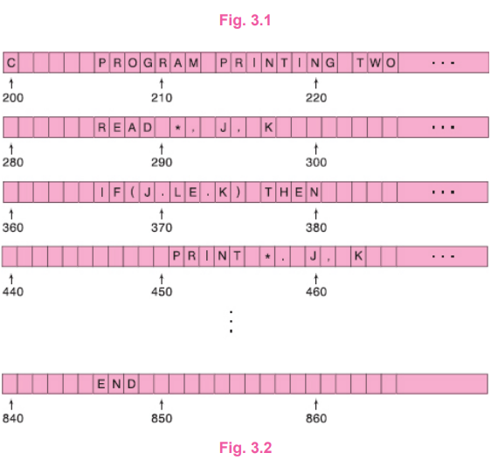
Record-Oriented, Fixed-Length Storage
In fixed-length storage each line of print is viewed as a record, where all records have the same length, i.e., where each record accommodates the same number of characters.
Since data are frequently input on terminals with 80-column images or using 80-column cards, we will assume our records have length 80 unless otherwise stated or implied.

Slide 7
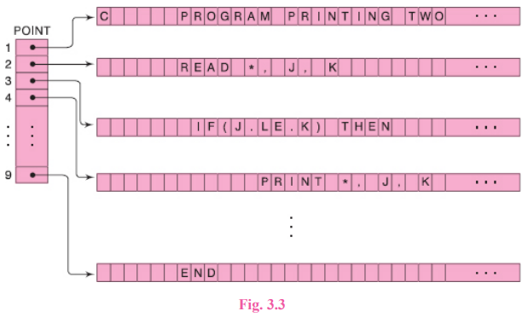
Record-Oriented, Fixed-Length Storage

Slide 8
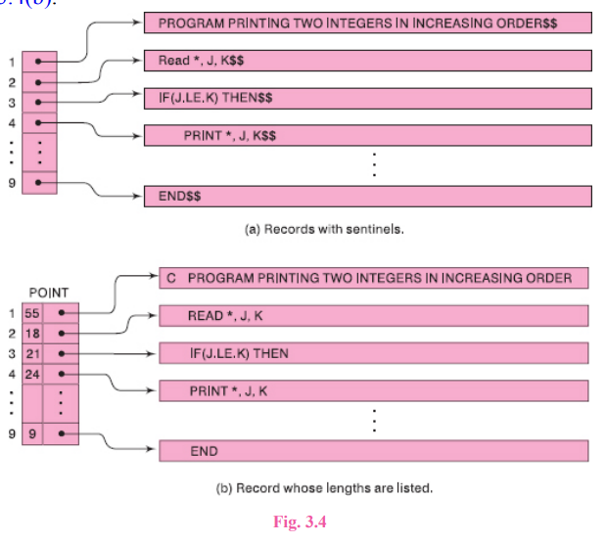
Variable-Length Storage with Fixed Maximum
The storage of variable-length strings in memory cells with fixed lengths can be done in two general ways:
One can use a marker, such as two dollar signs ($$), to signal the end of the string.
One can list the length of the string—as an additional item in the pointer array, for example.
Using the data in Fig. 3.1, the first method is pictured in Fig. 3.4(a) and the second method is pictured in Fig. 3.4(b).

Slide 9
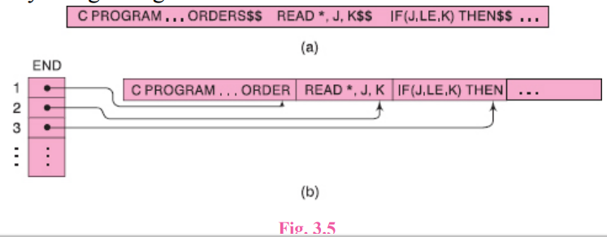
Variable-Length Storage with Fixed Maximum
One might be tempted to store strings one after another by using some separation marker, such as the two dollar signs ($$) in Fig. 3.5(a), or by using a pointer array giving the location of the strings, as in Fig. 3.5(b).

Slide 10
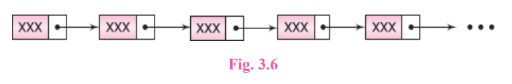
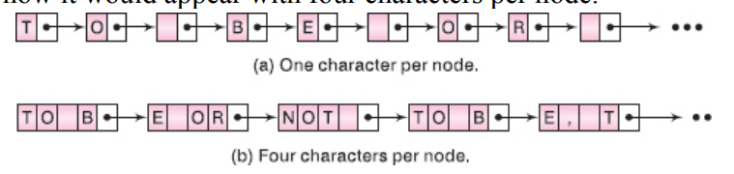
Linked Storage
Computers are being used very frequently today for word processing, i.e., for inputting, processing and outputting printed matter.
Therefore, the computer must be able to correct and modify the printed matter, which usually means deleting, changing and inserting words, phrases, sentences and even paragraphs in the text.

Slide 11
CHARACTER DATA TYPE
Constants
Many programming languages denote string constants by placing the string in either single or double quotation marks.
For example, 'THE END' and 'TO BE OR NOT TO BE' are string constants of lengths 7 and 18 characters respectively.
Variables
By a static character variable, we mean a variable whose length is defined before the program is executed and cannot change throughout the program.
By a semistatic character variable, we mean a variable whose length may vary during the execution of the program as long as the length does not exceed a maximum value determined by the program before the program is executed.
By a dynamic character variable, we mean a variable whose length can change during the execution of the program.

Slide 12
STRING OPERATIONS
Length : Number of characters
Substring : Part of a String
Indexing : Indexing, also called pattern matching
Concatenation : Joining of two string.
Word Processing
Replacement: Replacing one string in the text by another.
Insertion: Inserting a string in the middle of the text.
Deletion: Deleting a string from the text.

Slide 13
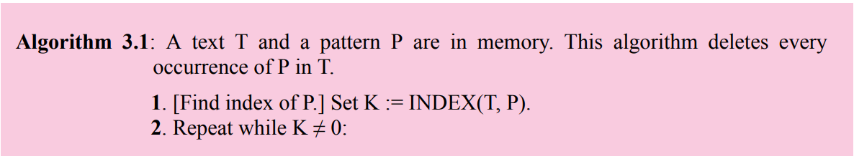
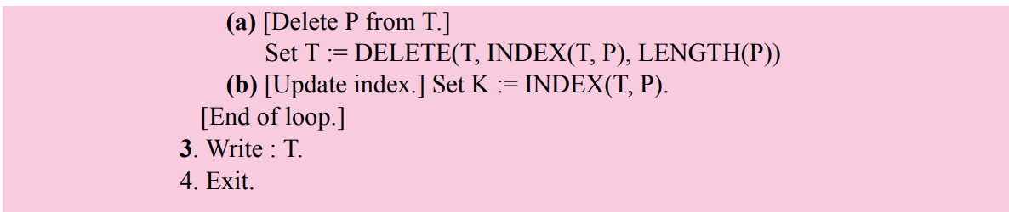
Deleting Algorithm

Slide 14
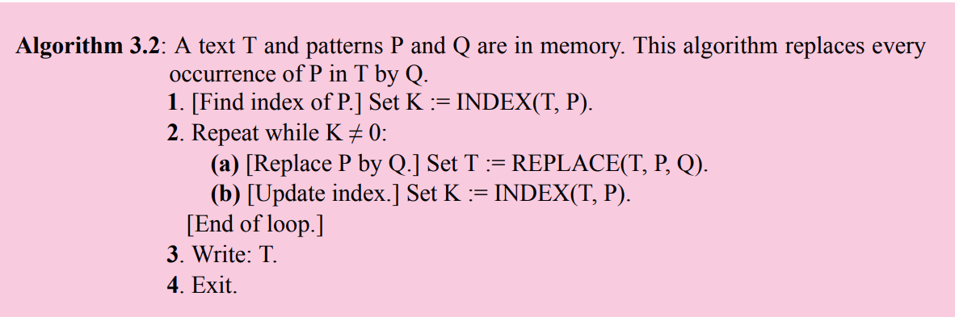
Replacement

Slide 15
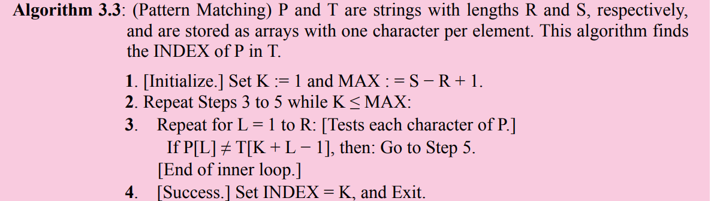

PATTERN MATCHING ALGORITHMS

Slide 16
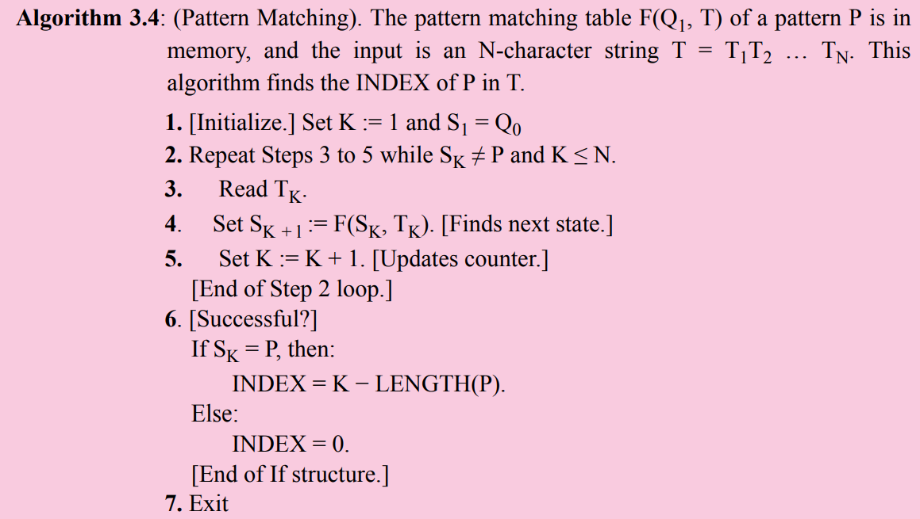

Slide 17
Important Sample Questions
Describe briefly the meaning of (a) static, (b) semistatic and (c) dynamic character variables.
Assuming a programming language uses at least 48 characters—26 letters, 10 digits and a minimum of 12 special characters—give the minimum number and the usual number of bits to represent a character in the memory of the computer.
Describe briefly the three types of structures used for storing strings.
Give some (a) advantages and (b) disadvantages of using linked storage for storing strings.
Recall that we use INSERT(text, position, string) to denote inserting a string S in a given text T beginning in position K.
(a) Find (i) INSERT('AAAAA', 1, 'BBB'), (ii) INSERT('AAAAA', 3, 'BBB') and (iii) INSERT('AAAAA', 6, 'BBB').
(b) Suppose T is the text 'THE STUDENT IS ILL. ' Use INSERT to change T so that it reads: (i) The student is very ill. (ii) The student is ill today. (iii) The student is very ill today.
3.13 Find (a) DELETE('AAABBB', 2, 2) and DELETE('JOHN PAUL JONES', 6, 5) (b) REPLACE('AAABBB', 'AA', 'BB') and REPLACE('JOHN PAUL JONES', 'PAUL', 'DAVID')
Write a procedure which counts the number NUM of paragraphs in the short story S.
Write a procedure which counts the number NUM of times the word “the” appears in the short story S. (We do not count “the” in “mother,” and we assume no sentence ends with the word “the.”
Discuss the changes that must be made in Procedure P3.15 if one wants to count the number of occurrences of an aribitrary word W with length R.

Slide 18
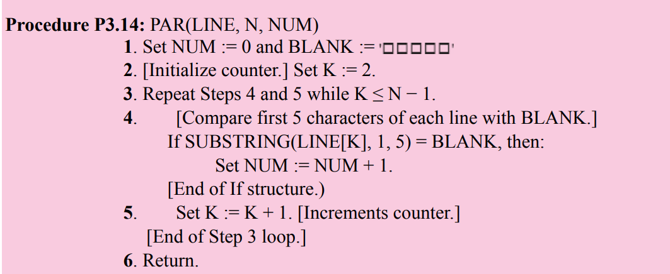

Slide 19
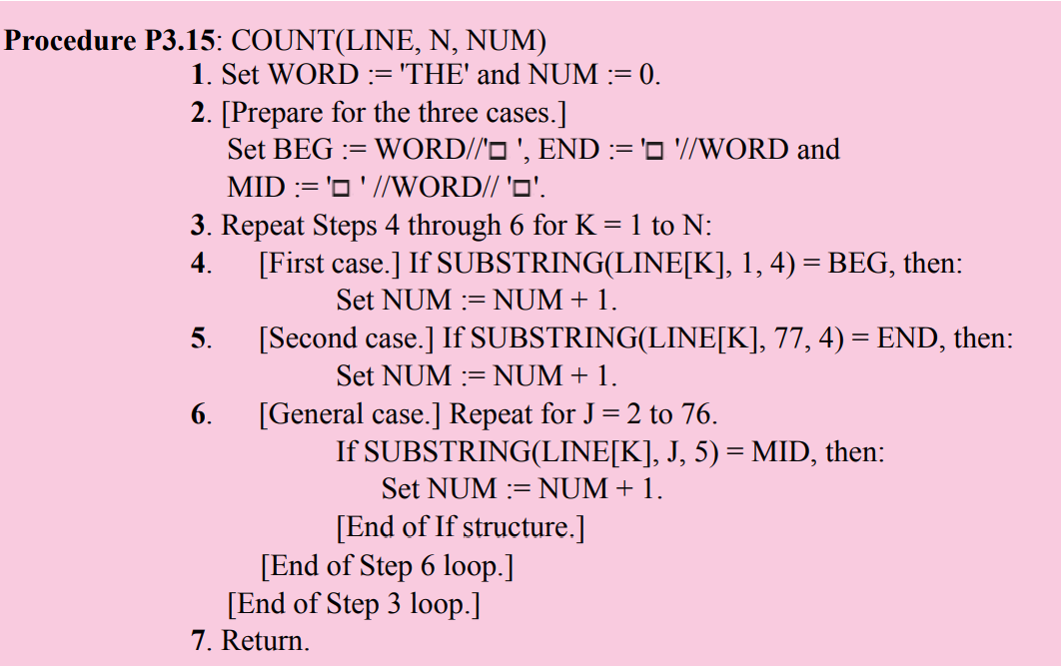

Slide 20
Next Week Topics
Arrays,
Records and
Pointers

Slide 21
Thank You

